Slide 1
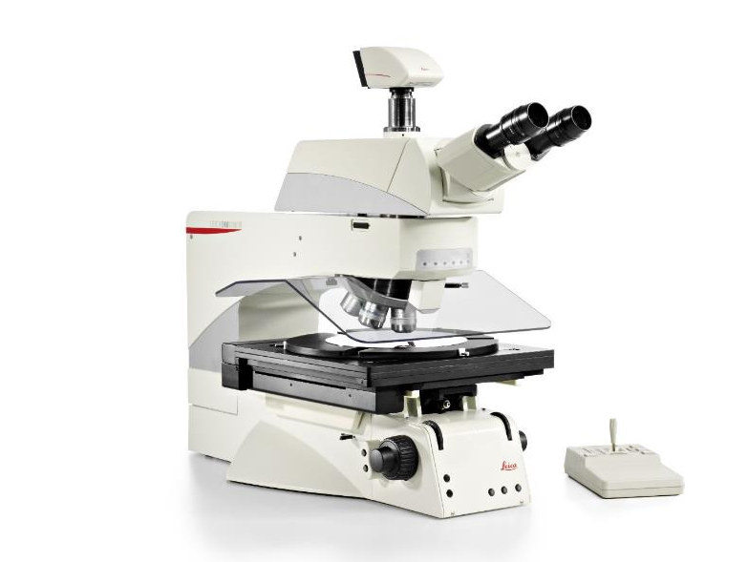
Large stage inspection systems
DM8000 M / DM12000 M
See More, Detect Faster

Slide 2
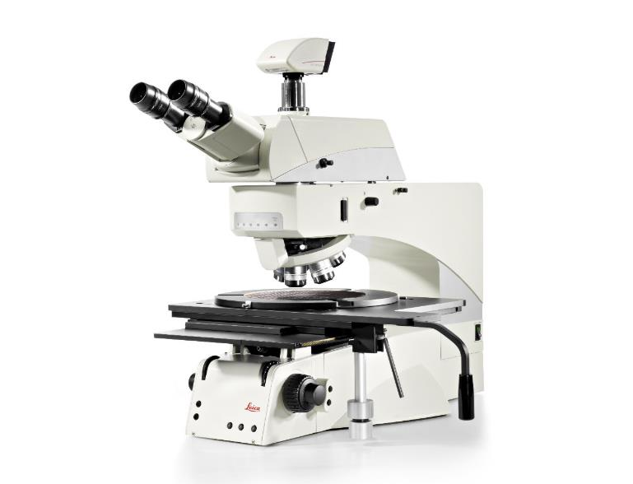

The DM8000 M and DM12000 M inspection systems
The DM8000 M / DM12000 M is a platform of a modular large stage inspection microscope offered for 8”/200 mm and 12”/300 mm sample inspection.
Manual inspection system
Motorized inspection system

Slide 3


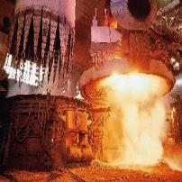
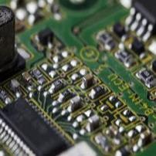
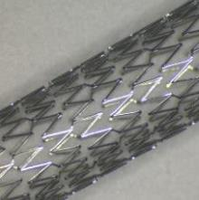
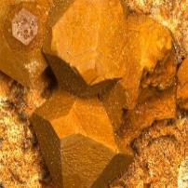
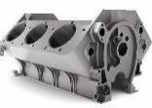
DM8000 M/DM12000 M: Overview of industries and applications
R&D
Production
Quality
Failure
analysis
Metals
Electronics &
Electrical
Transportation
Medical Device
Academia & Research Institutes
Examples:
Microelectronic & Semiconductor:
Flat panel
TFT displays
Masks
Wafer
Solar cells
Metals:
Multi sample analysis with the LAS X Steel Expert
Transportation:
Multi sample analysis with the LAS X Cleanliness Expert
Inspection of large samples

Slide 4
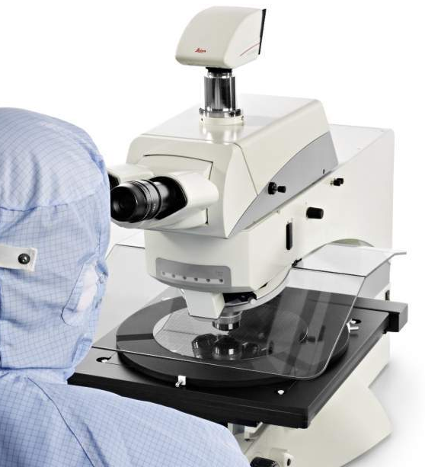
DM8000 M/DM12000 M: The step into the inspection world
.
See more information of the sample surface to improve your product quality decisions within shorter time of study​
Macro objective (Plan APO 0.7x) for fast sample overview
UV illumination for higher resolution can be combined with oblique illumination technique to gain additional sample surface information
Ergonomic design and automated features for fast and fatigue-free operation to avoid inattention during repetitive sample inspection
Intelligent workflow support by manual, coded and motorized function to speed up sample inspection
See More, Detect Faster!
High-throughput inspection system

Slide 5
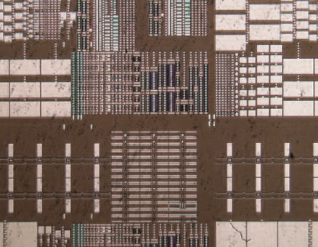
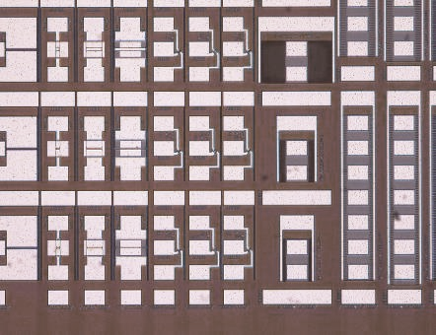
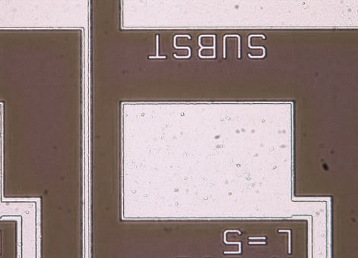
DM8000 M/DM12000 M benefits: Fast sample overview
From Macro objective (Plan APO 0.7x) for fast sample overview to micro to see the finest details.
See 35.7 mm of the sample surface with 25 field-of-view (FOV) eyepieces
See macro defects that are “invisible” at higher magnification like areas of missing exposure, shark teeth structures or flow structures in material samples at a glance.
No need for time consuming scanning of the sample when inspection of macro structures is necessary
Simply switch to higher magnification (Obj. HC PL APO 150x/0.90 IVIS BD) to see finest details
0.7x Macro overview
5x BF
50x BF

Slide 6
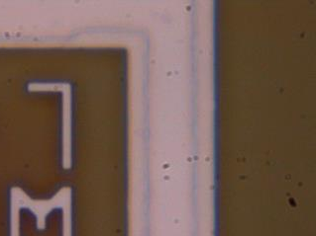
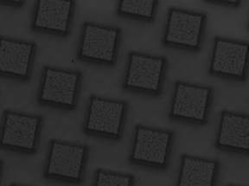
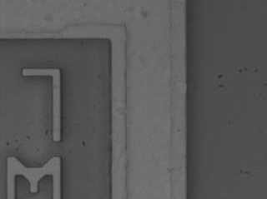
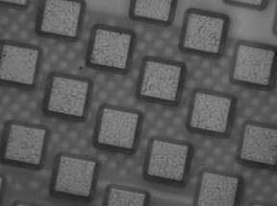
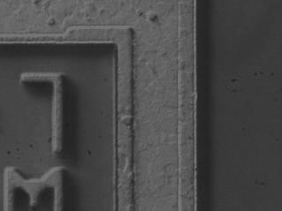
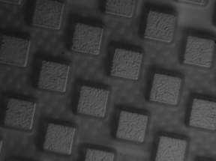
DM8000 M/DM12000 M benefits: More information on the sample surface within shorter time
c
Wafer microstructure
Bumps on substrate
UV illumination for higher resolution can be combined with Oblique illumination technique to gain additional sample surface information
Inspect the sample at high magnification (150x) in color mode with brightfield, darkfield or interference contrast to reveal sample defects.
Increase the optical resolution by activating the UV illumination to visualize finest structures.
Turn surfaces of low contrast at high resolution into crisp structured topographies to reveal defects at a first glance.
150x BF
Increasing
resolution
c
150x UV
Increasing
contrast
c
150x OUV
Multi-functional HC PL APO 150x/0.90 IVIS BD
objective: BF, DF, DIC, UV and oblique UV (OUV)

Slide 7
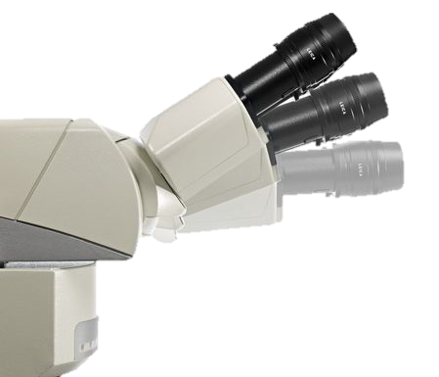
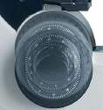
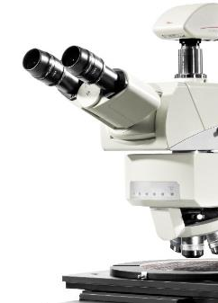
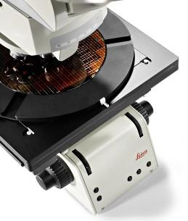
DM8000 M/DM12000 M benefits: Higher quality due to ergonomic features
Ergonomic design and automated features for fast and fatigue-free operation to avoid inattention during repetitive sample inspection.
Height-adjustable focus knobs: Ergonomic for operators with different hand sizes. Integrated mechanical focus protection and torque adjustment for safe and fast operation.
ErgoTube: Individually adjustable viewing height for fatigue-free sample inspection. Upright image allows fast orientation on the sample also for untrained users.
Automated features: Front side Status LED display and programmable function keys for motorized and semi-motorized versions for easy and fast microscope operation.
ErgoTube
Height adjustable focus knobs
Function keys
Status indicator

Slide 8
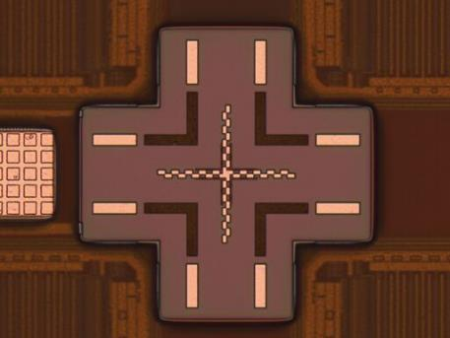
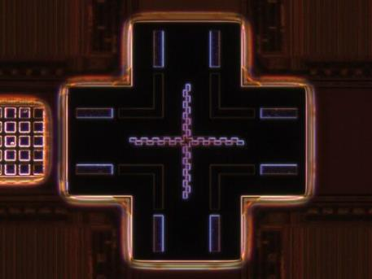
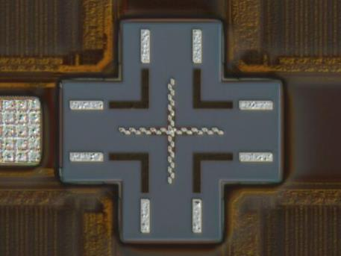
DM8000 M/DM12000 M benefits: Workflow support by intelligent functionality
Intelligent workflow support by manual, coded and motorized function to speed up sample inspection*
Illumination and contrast settings are automatically adjusted for the selected method by a single click of a button to save time and to avoid errors*.
Integrated LED illumination for visible and UV light allows switching between different illumination techniques within seconds and optimize airflow around the microscope to keep the cleanroom clean.
Build-in focus finder for the inspection of highly reflecting surfaces to find the correct focus position quick and easy.
*for motorized and semi-motorized versions
20x BF
20x DF
20x DIC

Slide 9
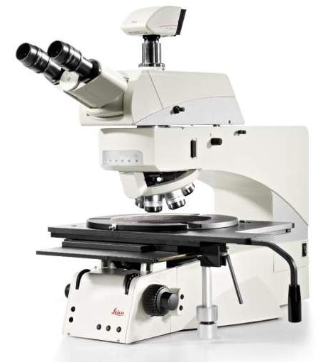
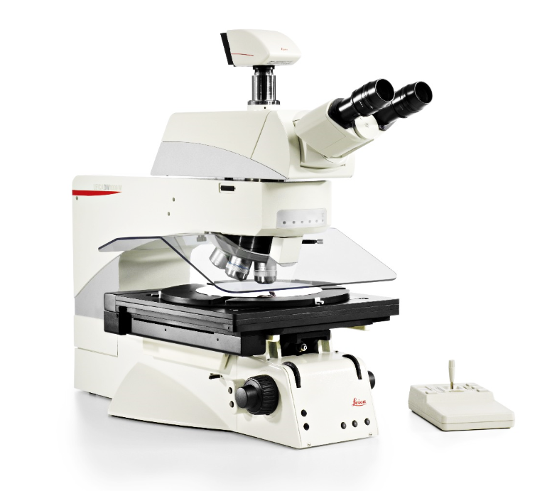
DM8000 M/DM12000 M: System concept
DM8000 M / DM12000 M man
(manual 8”/12” version)
(Nearly) all microscope functions manual
Mot. objective nosepiece, mot. aperture diaphragm
RL and RL/TL version
DM8000 M / DM12000 M mot
(motorized 8”/12” version)
Incl. contrast manager
Incl. light manager (mot. aperture/intensity)
Mot. objective nosepiece, mot. stage, mot. focus
RL and RL/TL version
Plus
Micro / Macro function
Oblique illumination
In-depth Darkfield
LED illumination
Plus
Option to choose between two incident light axis:
Electronic (standard samples)
Material (high samples)

Slide 10
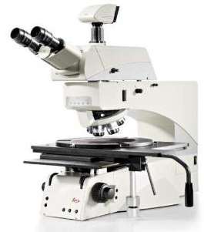
Available configurations
Solution​ | DM8000 M / DM12000 M man. |  | DM8000 M / DM12000 M mot.​
Use when …​ | Basic inspection of large samples on a weekly basis with moderate sample throughput and manual sample positioning is needed |  | Reproducible and reliable results for standardized inspection with high sample throughput in a multiuser environment are needed.
Your need …​ | Manual inspection Inspection of samples with weak contrast Inspection of fine structures |  | Motorized sample positioning Multisampling capability Intelligent microscope support to reduce inspection time Inspection of samples with weak contrast Inspection of fine structures
Options
​Stage | Manual stage only |  | Manual or motorize stage
IL axis | “Microelectronic” incident light axis for standard samples “Material” incident light axis for higher samples (i.e. metallographic) -> Sample height >42mm. For smaller samples a stage insert is required |  | “Microelectronic” incident light axis for standard samples “Material” incident light axis for higher samples (i.e. metallographic) -> Sample height >42mm. For smaller samples a stage insert is required
 | Motorized incident light axis can be combined with manual base |  | Manual incident light axis can be combined with motorized base
0.7x Macro objective | Motorized IL axis recommended for ease of use
UV illumination | Configurable for manual and motorized Incident light axis
Oblique illumination | Also in manual IL axis motorized |  | Motorization included

Slide 11
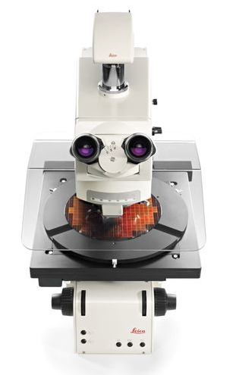
Summary
See more information of the sample surface to improve your product quality decisions within shorter time of study​
Fast sample overview with the Plan APO 0.7x macro objective
Gain more sample surface information by higher resolution and crisp contrast with UV and oblique illumination
Fatigue-fee and fast operation to avoid inattention during repetitive inspection workflow by ergonomic design and automated features
Speed up sample inspection possible by intelligent workflow support with manual, coded and motorized function
Comparable results with reproducible constant color temperature by high power LED illumination for industry contrasting techniques
Find defects faster by higher contrast supported by the advanced darkfield technique with Plan Fluotar objectives (20x, 50x and 100x)

