Slide 1
Cleanliness Analysis Solutions
Target contamination fast

Slide 2
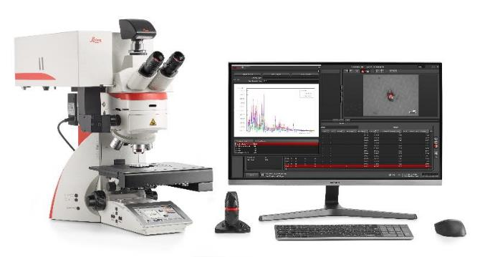
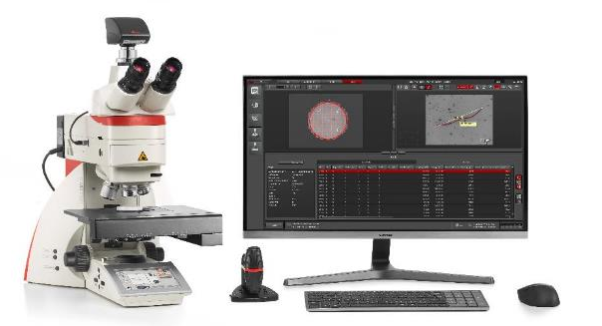
Cleanliness analysis solutions
The cleanliness analysis solutions can help you ensure better product performance and lifetime through efficient and reliable technical cleanliness by analyzing particle quantity, size, and composition.
DM6 M LIBS
DM6 M microscope
Emspira 3 digital microscope

Slide 3

Cleanliness analysis solutions
Target contamination fast
The cleanliness solutions allow you to fast-forward to your results, get more insights on particles and work flexibly today and in the future.
Your benefits
Increase throughput by analyzing more in less time.
Obtain more insights on the source of particles for better risk assessment and more confident decisions.
Meet all your current needs and be prepared for changing requirements.

Slide 4
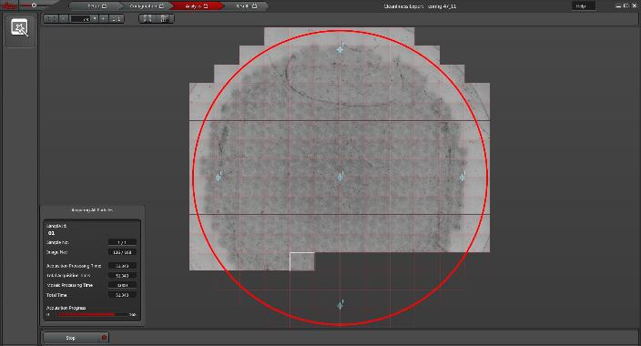
Spend less time on scanning and analysis
Save 30% of your time* when scanning filter samples for particle sizes between 5 and 10 µm⁺ .
Scan particles on filters 3x faster* for sizes above 25 µm#.
Scanning a filter with the Cleanliness Expert software.
*Compared to a conventional microscope.
⁺ Using a DM6 M microscope with a K3C camera and Cleanliness Expert software.
#Using an Emspira 3 digital microscope and the Cleanliness Expert software.

Slide 5
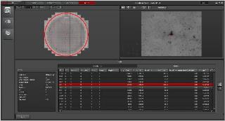
Analyze your samples faster
Efficiently identify particles and analyze data with optimized algorithms.
Identify the reflective particles on your filter sample faster.
Calculate the circular diameter imposed on oddly shaped particles with improved speed.
Results from cleanliness analysis using the Cleanliness Expert software.

Slide 6
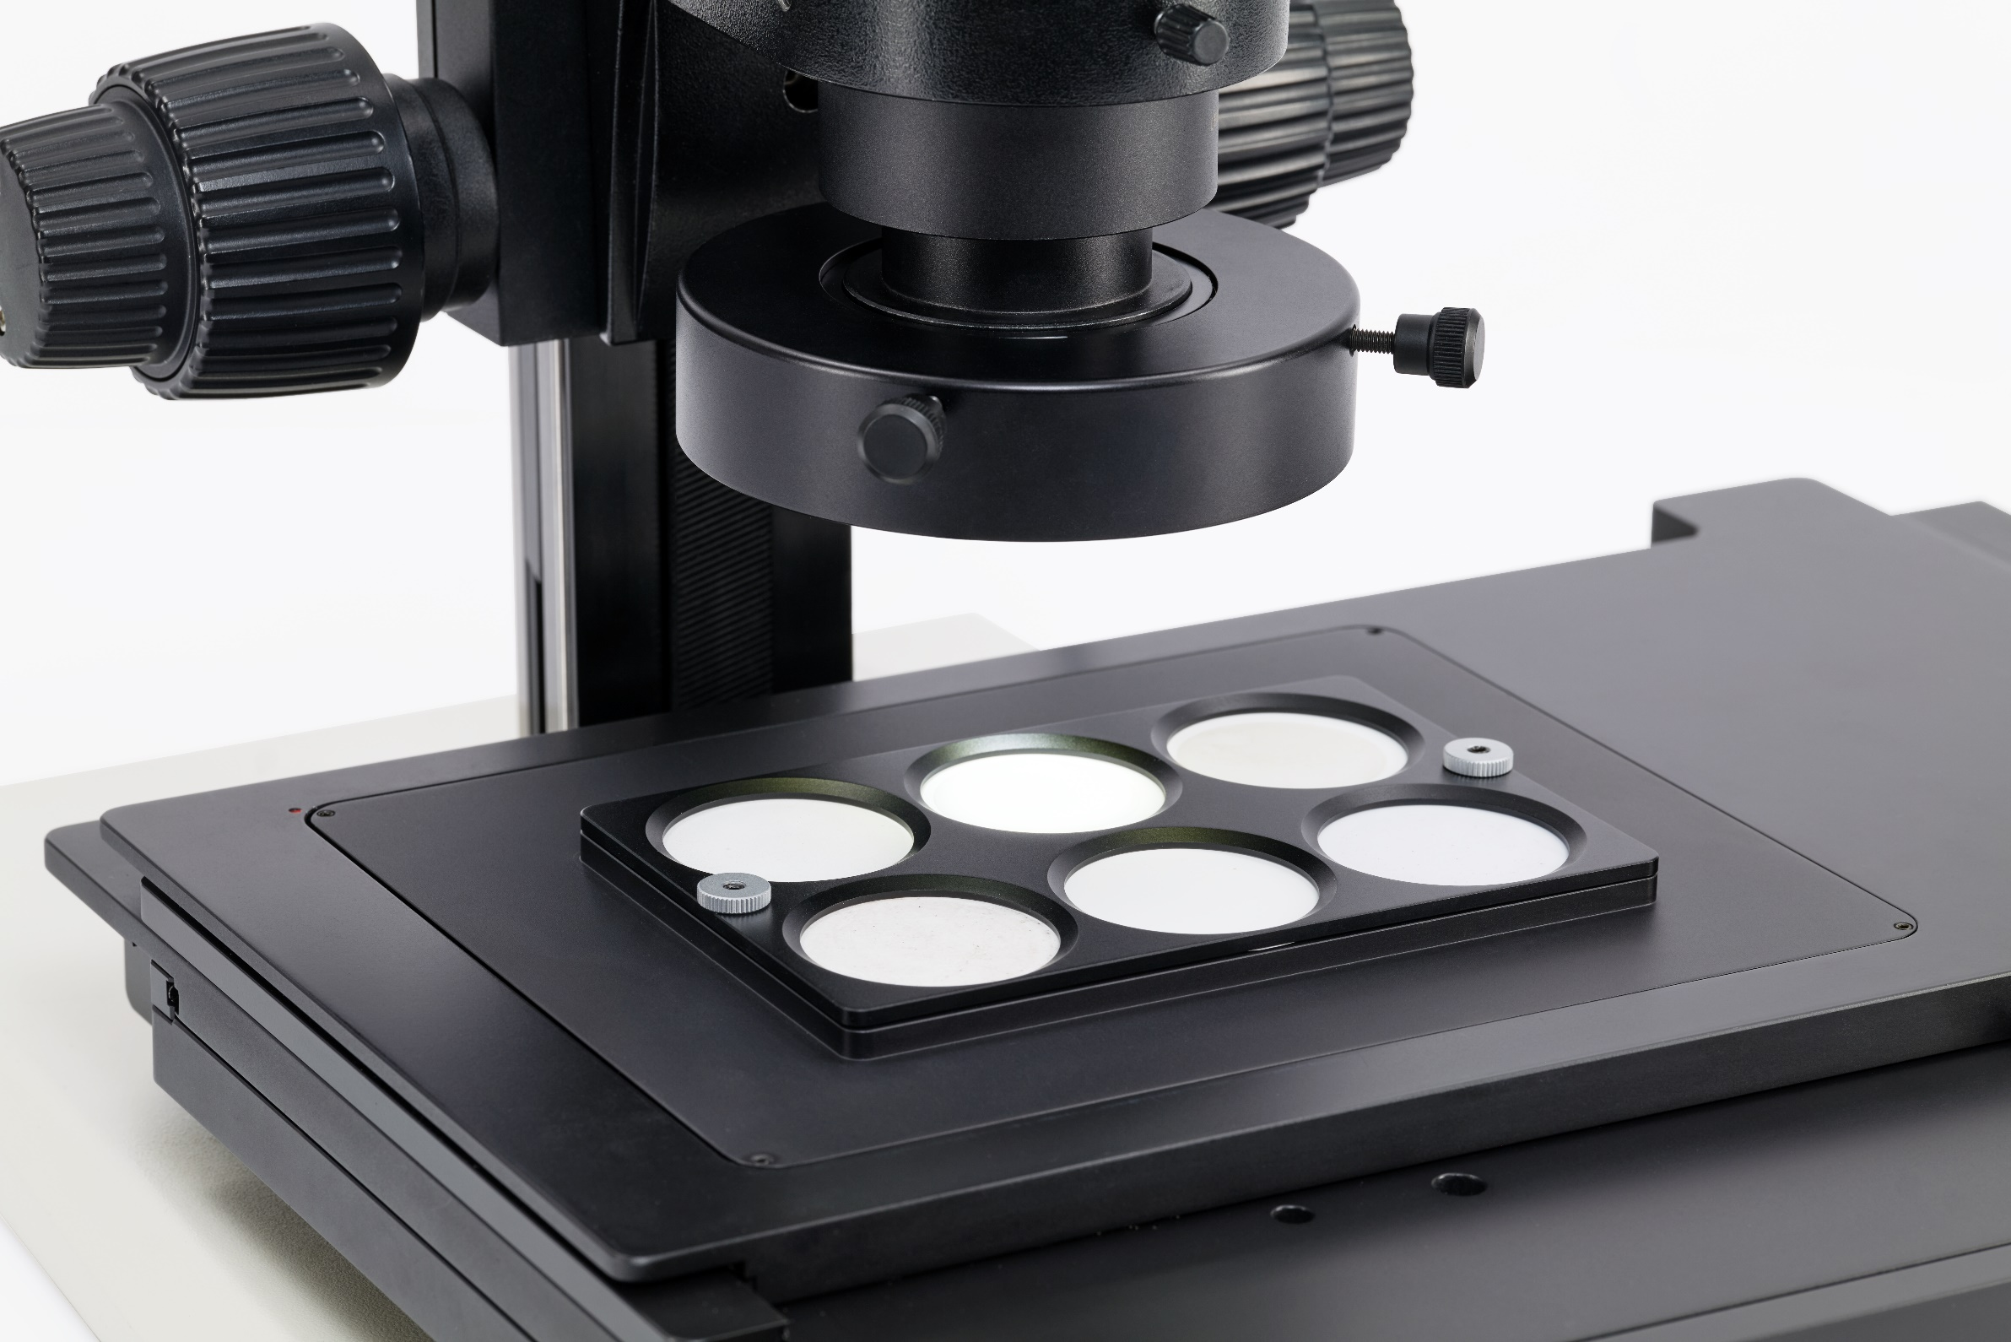
Process more than one sample at the same time
Simplify your workflow by continuous unattended analysis of multiple filter samples.
Save time by analyzing a batch of filters with the automated particle analysis.
Customize your analysis for each filter by setting different parameters for particle classification, such as length and width limits.
Multiple filter samples from a single batch can be analyzed at one time.

Slide 7
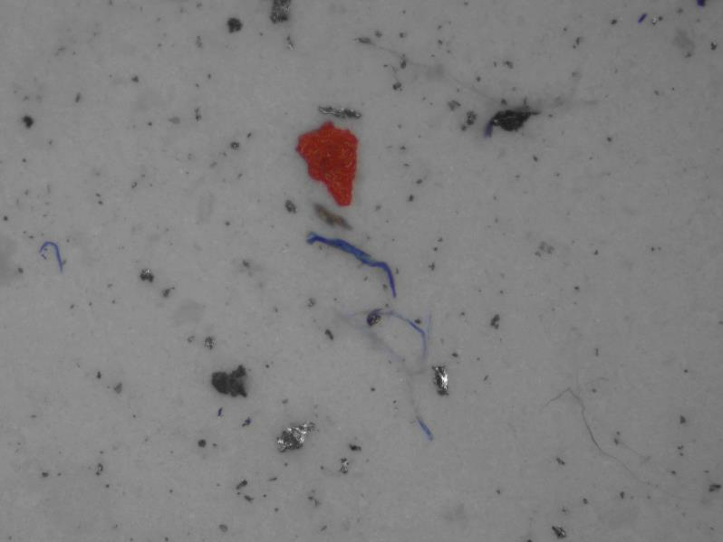
Identify “killer particles” more reliably
The harder and larger a particle is, the higher its damage potential.
Automatic differentiation between metallic (reflective) and non-metallic (non-reflective) particle types.
Easily distinguish the difference between particles and fibers.
Measure particle height easily with automated tools.
Multiple particles seen on a filter imaged with a microscope.

Slide 8
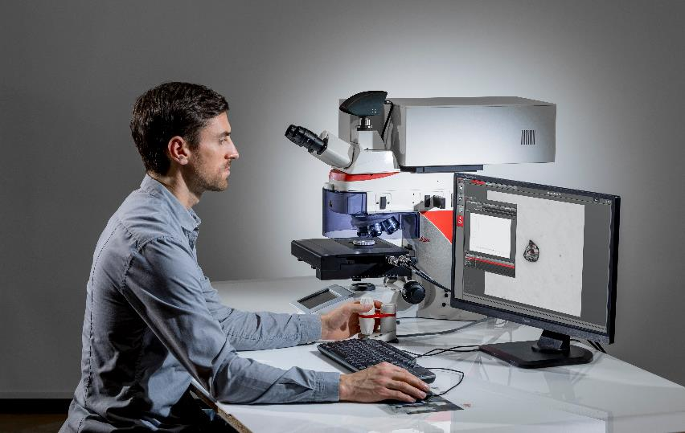
Get a laser focus on the source of contamination
Find the contamination source more efficiently with simultaneous visual and chemical analysis, a 2-in-1 solution which combines Cleanliness Expert software and Laser Induced Breakdown Spectroscopy (LIBS).
Complete your entire analysis workflow with a single instrument.
Eliminate time wasted on sample transfer between instruments and additional sample preparation.
Save 90% of time taken to determine microstructure composition.
Cleanliness analysis performed with a LIBS system.

Slide 9
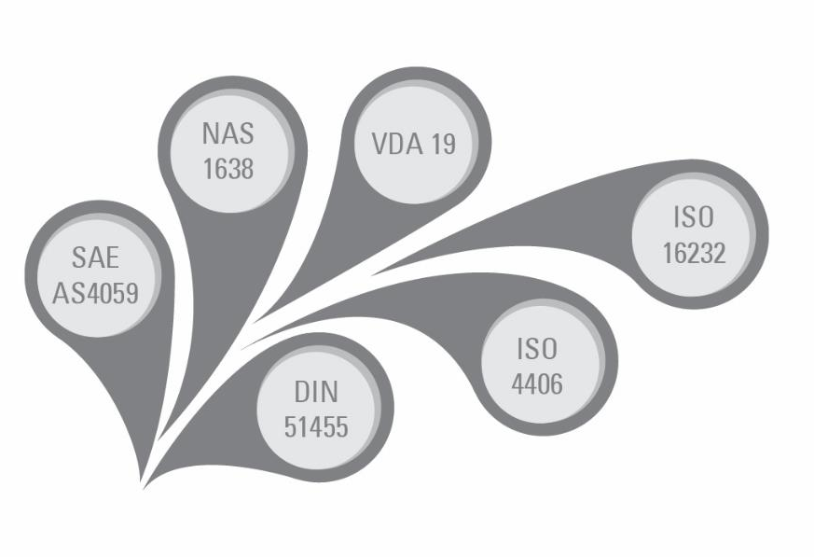
Meet your requirements today
Meet various international and regional standards and keep the applied standards up-to-date with update applications.
ISO 16232 and VDA 19 for automotive
ISO 4406 and DIN 51455 for hydraulic fluids and oil
USP 788 for pharmaceutical manufacturing
Perform analyses in accordance with organizational norms and processes by creating custom-defined standards.
Various international and regional standards.

Slide 10
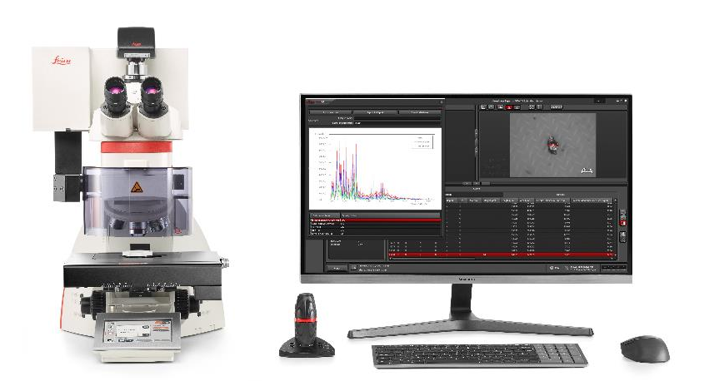
A path to meet your future needs
Advance to simultaneous visual and chemical particle analysis by upgrading to a 2-in-1 solution. The DM6 M microscope can be easily retrofitted with a Laser Induced Breakdown Spectroscopy (LIBS).
Adapt your cleanliness solution for visualizing smaller particles with higher magnification objectives.
DM6 M LIBS 2-in-1 cleanliness analysis solution.

Slide 11


Available solutions for cleanliness analysis
Find the solution that best fits your needs: | Emspira 3 | DM6 M | DM6 M LIBS
General specs. | Coded zoom body | Coded/mot. nosepiece, illumination and contrast manager | Mot. nosepiece, illumination and contrast manager
Particle size (recommendation) | Down to 25 µm | Down to 5 µm | Down to 5 µm
Risk analysis of particles by metallic glare | Automated | Automated | Automated
Risk analysis of particle dimension | Fmax, Fmin, ICD | Fmax, Fmin, ICD, height | Fmax, Fmin, ICD, height
Chemical analysis of particles material | Not available | Upgradable for DM6 M | Included
Further application possibilities | Macro inspection | Micro inspection | Material analysis
Standards in: Automotive industry (ISO 16232, VDA 19) | X | X | X
Lubricants and hydraulic fluids (ISO 4406, DIN 51455, SAE AS4059) | Not recommended to use | X | X
Injections and parenteral infusion fluids USP 788 | Not recommended to use | X | X

Slide 12


Cleanliness analysis solutions
Emspira 3 digital microscope with Cleanliness Expert analysis software
Use standard configuration for
Particle sizes down to 25 μm
Automated recognition of metallic and non-metallic particles and between particles and fibers with the VisiLED ring light
2D measurement of particles
DM6 M microscope, K3C camera, and Cleanliness Expert analysis software
Use advanced configuration for
Particle sizes down to 5 μm
Fully automated recognition of metallic and non-metallic particles and between particles and fibers
3D measurement of particles
DM6 M microscope with LIBS, K3C camera, and Cleanliness Expert analysis software
Use professional configuration for
Particle sizes down to 5 μm
Fully automated recognition of metallic and non-metallic particles and between particles and fibers
3D measurement of particles
Simultaneous particle composition identification
No sample transfer or additional sample preparation

Slide 13
Summary
Target contamination fast
The cleanliness analysis solutions can help you ensure better product performance and lifetime through efficient and reliable technical cleanliness by analyzing particle quantity, size, and composition.
Fast-forward to your results: Increase throughput by analyzing more in less time.
Get more insights on particles: Obtain more insights on the source of particles for better risk assessment and more confident decisions.
Work flexibly today and in the future: Meet all your current needs and be prepared for changing requirements.

