Slide 1
Educational material science microscope
DM750 M
Increase learning time

Slide 2
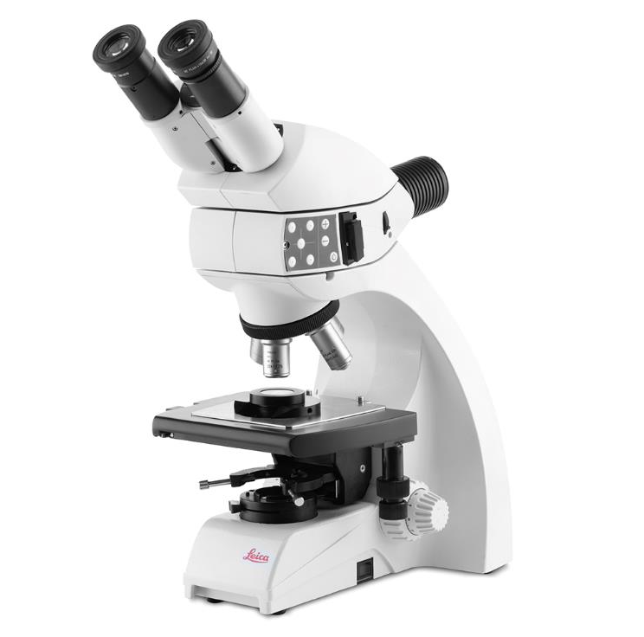
DM750 M educational material science microscope
The DM750 M educational material science microscope is designed for viewing metallurgical and other opaque specimens.

Slide 3


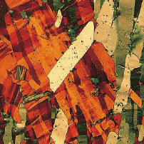
Overview of applications
Higher Education Material Science Microscopy Classrooms
Metals
Surface structure
Natural resources
Examples:
Study metals and other opaque materials
Analyze surface structures in various samples
Learn from viewing samples of natural resources

Slide 4
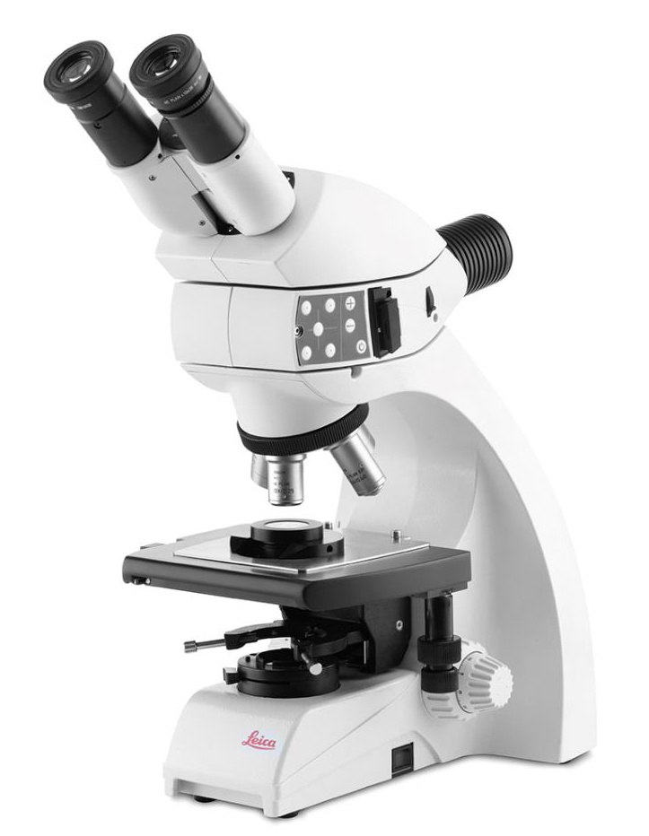
DM750 M: Increase learning time
Increase learning time with student friendly, time saving, and image sharing features
Easy image sharing with the compatible multiple connection camera; including Wi-Fi
Fast transport to and from storage with integrated vertical handle and cord wrap
Easy sample handling with the versatile stage
Efficient analysis with the multi-function reflected light illuminator
Ideal for higher education student use.

Slide 5
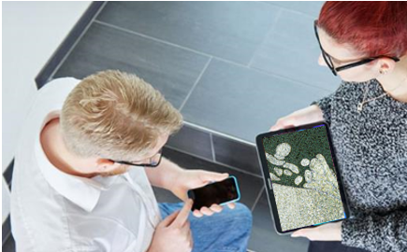
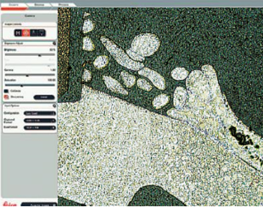
DM750 M benefits: Easy image sharing
Easy image sharing with the compatible multiple connection camera; including Wi-Fi
Adapt to the device with the ability to save images to a mobile device, SD card, or PC
No other network needed. Connect directly to camera via Wi-Fi¹
Simple image display by directly connecting to an HD monitor
Variety of camera control and image processing with imaging software from Leica Microsystems
¹ Only available for ICC50 W

Slide 6
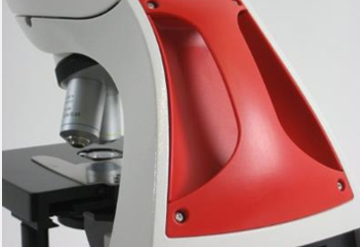
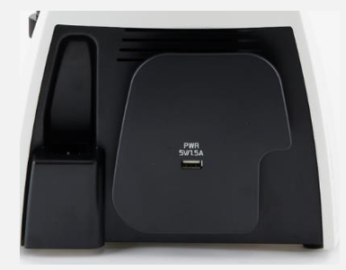
DM750 M benefits: Fast transport for storage
Fast transport to and from storage with integrated vertical handle and cord wrap
Easy to lift onto shelves using the vertical handle (accompanied by a cut out in the front of the stand)
Students are prompted to use the handle due to its red color
Small storage profile and neat workspace thanks to the integrated cord wrap
Less cabling due to the USB power for the camera integrated as part of the cord wrap

Slide 7
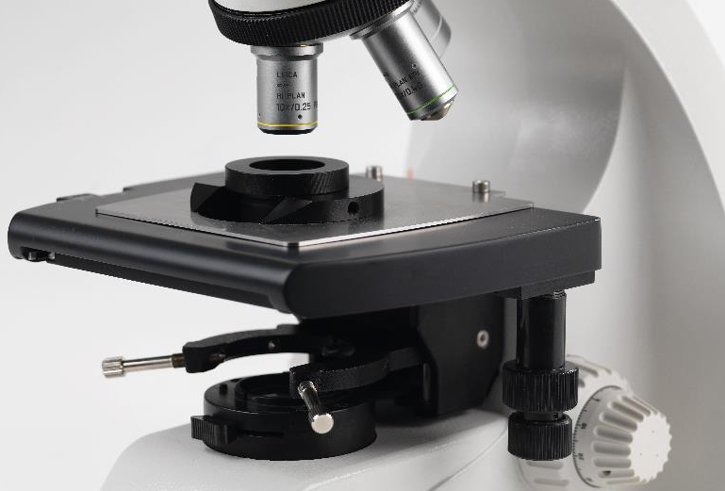
DM750 M benefits: Easy sample handling
Easy sample handling with the versatile stage
Fast manipulation of a variety of samples thanks to the universal stage with coaxial XY drive which allows observation of polished and/or etched samples with heights of up to 30 mm. Translucent samples can also be viewed
Versatility of sample preparation with the special sample holders for 25 mm or 30 mm sample diameters
Precise XY positioning of the sample with the object guide which securely holds the samples

Slide 8
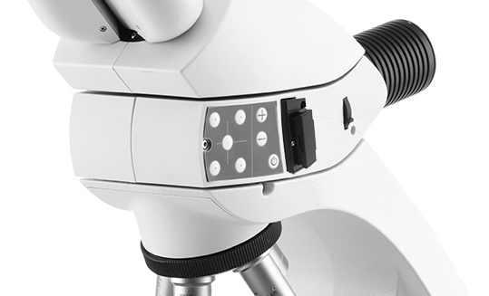
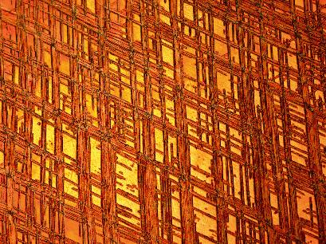

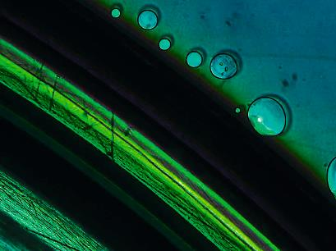
DM750 M benefits: Efficient analysis
Efficient analysis with the multi-function reflected light illuminator
Adapt to analyzing opaque specimens with various surface structures using the reflected light illuminator capable of on axis or oblique illumination as well as polarized light
No interruption from blown bulbs thanks to the long-life LED light source with (20,000 hours +)
Copper-zinc deformation line
Polished light metal, reflected light, brightfield-oblique contrast
DVD, reflected light, brightfield, crossed polarizer

Slide 9
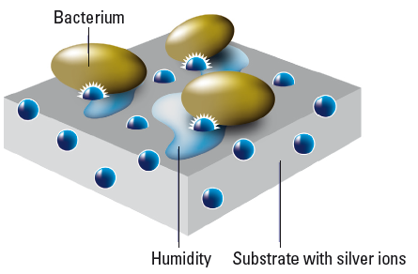
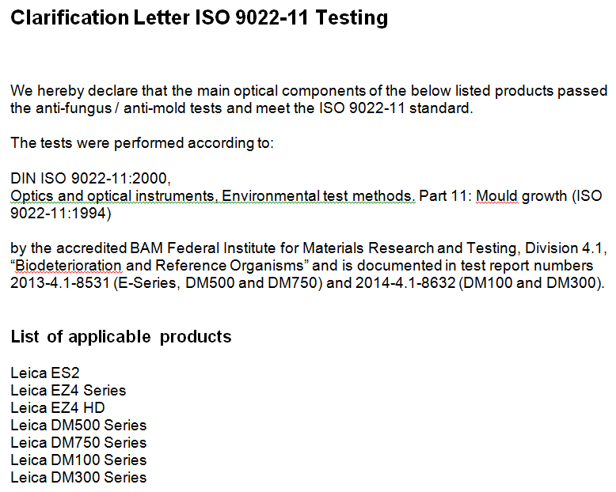
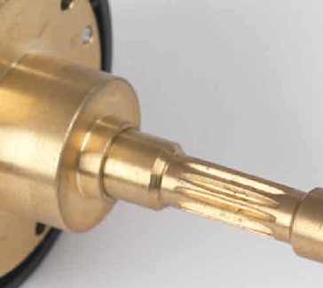
DM750 M technologies: Protect students and investment
AgTreat to help prevent the spread of bacteria by the main microscope touchpoints
Main optical components pass the ISO anti-mold tests
Robust brass shaft focus drive for long service life

Slide 10

DM750 M model
Solution | DM750 M
Use when … | Material science courses for learning about metals, natural resources, and other opaque samples
Your need … | Various reflected light techniques Easy sample handling Fast transport to and from storage Image documentation (integrated network and Wi-Fi camera)

Slide 11
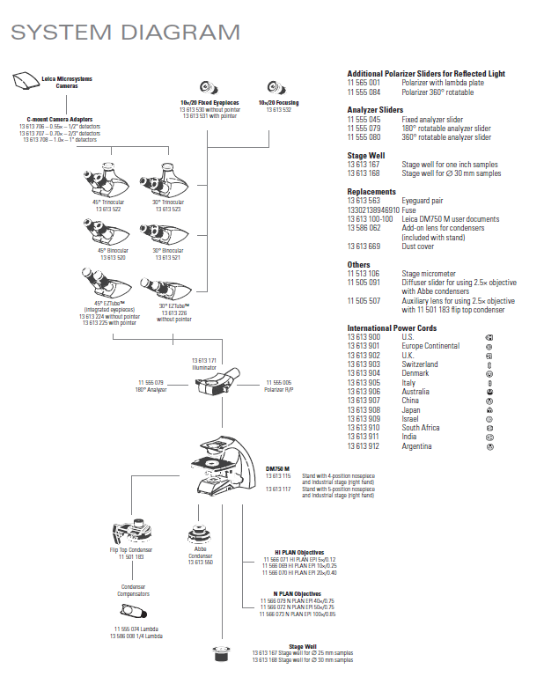
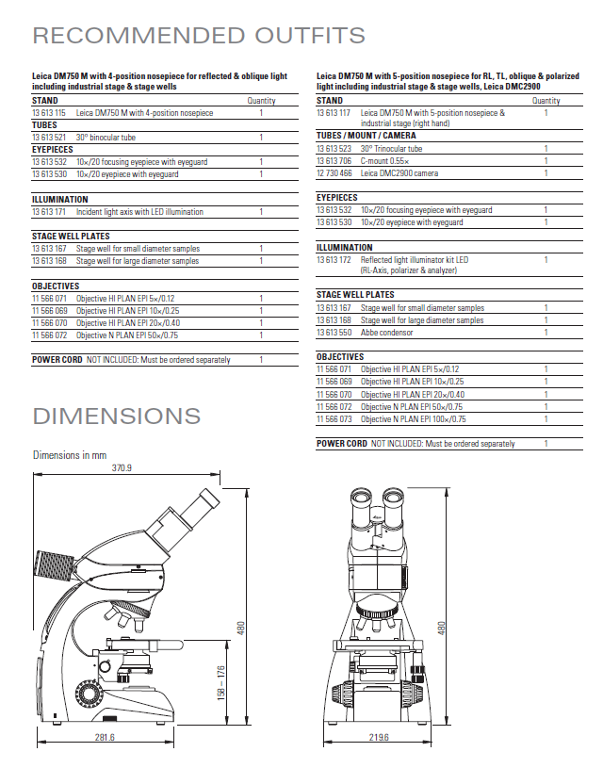
Optional configurations and accessories
For your application needs
Selection of eyepieces, objectives, etc.
Different recommended configurations

Slide 12

Summary
The DM750 M educational material science microscope
Increase learning time
Easy image sharing with the compatible multiple connection camera; including Wi-Fi
Fast transport to and from storage with integrated vertical handle and cord wrap
Easy sample handling with the versatile stage
Efficient analysis with the multi-function reflected light illuminator

Slide 13
Thank you.

