Slide 1
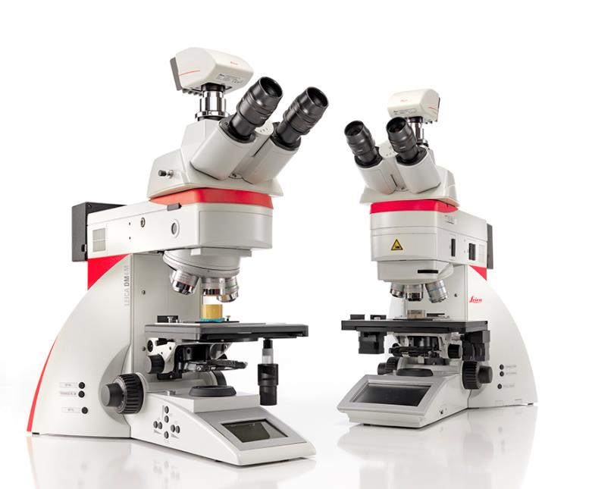
Upright Microscopes
DM4 M & DM6 M
Simply Microscopy

Slide 2
DM4 M/DM6 M platform for industrial applications
The DM4 M/DM6 M platform for industrial applications is a platform of dedicated upright microscopes offered in 2 basic configurations.
Optional additional accessories:
Enhance functionalities when tasks change over time
DM4 M:
A coded semi-automated microscope
DM6 M:
Offers automated functionalities

Slide 3


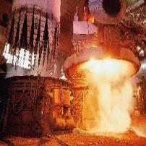
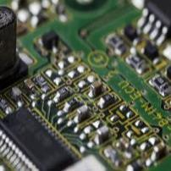
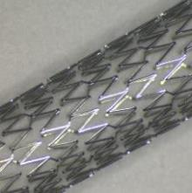
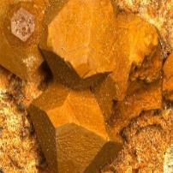
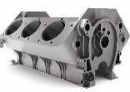
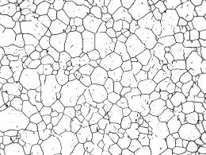
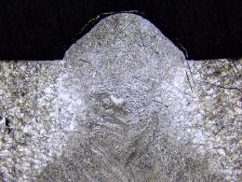
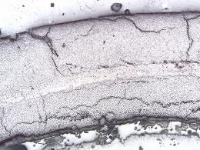
DM4 M/DM6 M: Overview of industries and applications
R&D
Production
Quality
Failure
analysis
Metals
Electronics &
Electrical
Transportation
Medical Device
Academia & Research Institutes
Examples:
Metallography
Grain size
Phase analysis
Layer thickness
Decarburization
Steel inclusion rating
Inspection
e.g.
Material inspection
(metal, plastic, glass,…)
PCB Boards inspection
Failure analysis
e.g.
Fracture analysis in
power plants

Slide 4
DM4 M: Simply Microscopy
Semi-automation: Automation where you need it, manual control where you want it
Automated functions (filter turret and illumination settings) for repeatable and reproducible settings
Quick changeover of sample, sample position and magnification? The ultimate control is in your hands – literally
High-definition darkfield* for more information on the sample surface within shorter time.
* Available for 20x, 50x, and 100x Plan Fluotar objectives

Slide 5
DM6 M: Simply Microscopy
Full automation: Additionally, expand automation to workflows which include repetitive tasks
Automated sample positioning*, large scale image acquisition (mosaic image), multi-sample analysis and acquisition of images with extended depth of field
Automated motorized DIC contrast operation
Automated compensation of sample surface inclination and camera misalignment* and focus deviation after magnification changeover
One-click changeover* of different microscope settings by motorized filter turrets and nosepieces to speed up the workflow
Ideal for high throughput or multi-user environment
* Configurable and available with LAS X and respective software modules

Slide 6
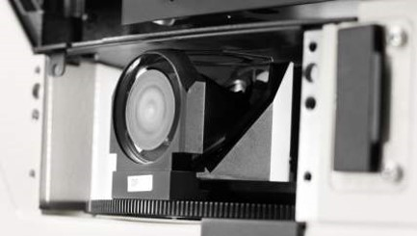
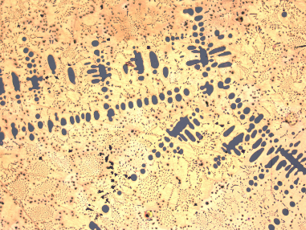
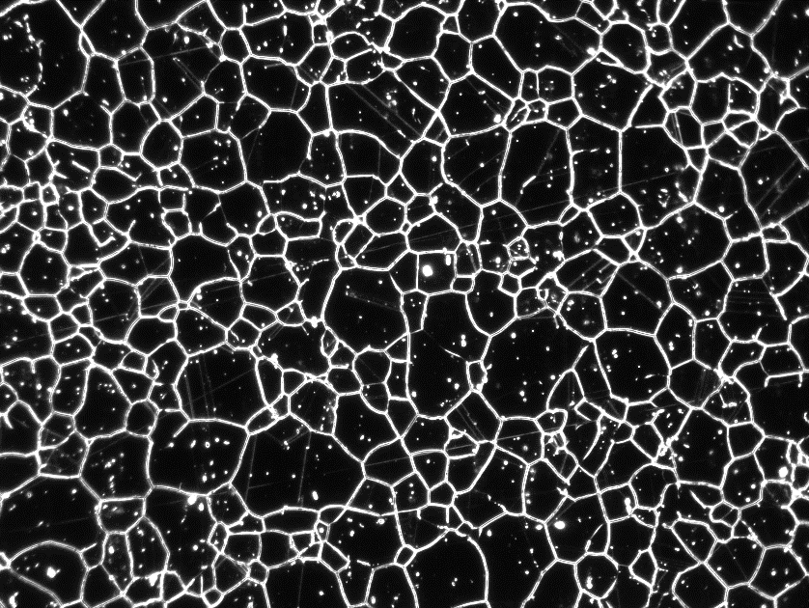
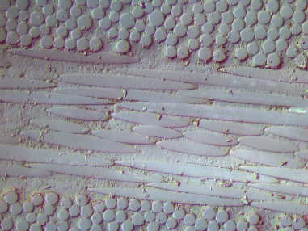
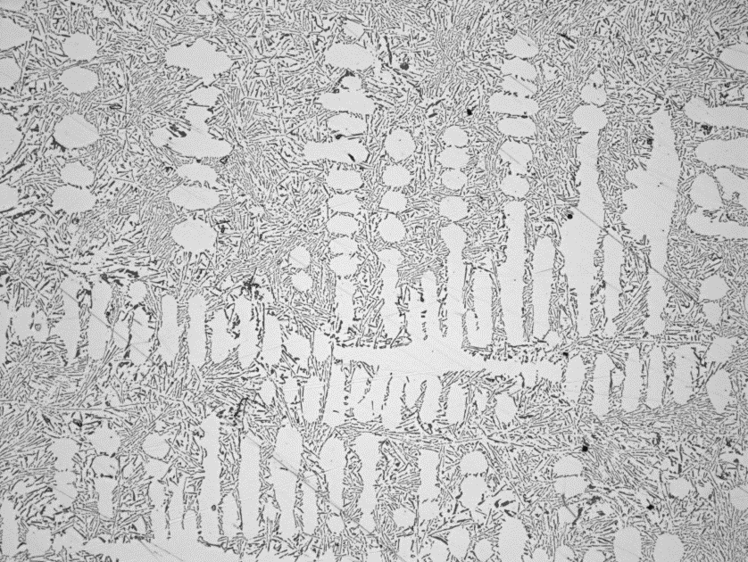
DM4 M/DM6 M benefits: Repeatable and reliable results
Get correct calibrated images for reliable and repeatable results by coded nosepieces and filter turrets
Images are automatically calibrated and illumination and contrast settings are applied
Settings are automatically saved with the image
Applicable for a wide range of magnifications and multiple contrast techniques
Repeatable results are supported by high power LED illumination with constant color temperature.
Brass at 10x, brightfield
Sample prepared for grainsize analysis at 10x, darkfield
Composite material at
50x, ICR
Etched iron sample at
50x, ICR

Slide 7
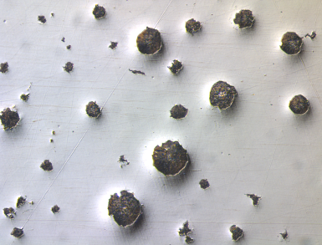
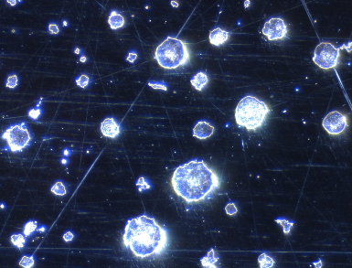
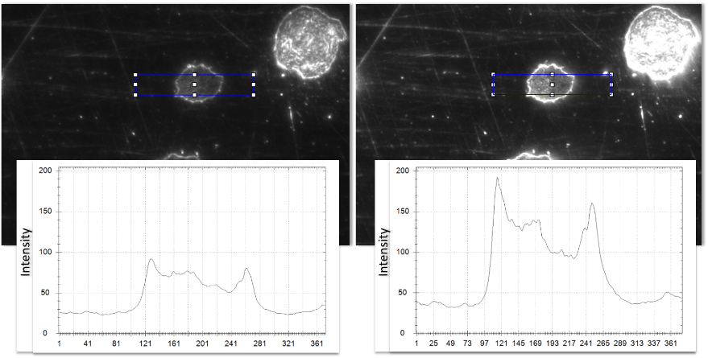
DM4 M/DM6 M benefits:
More information on the sample surface within shorter time
Get more information within shorter time of study by better contrast of the sample surface
Reveal uneven and cragged surfaces using partially (DM4 M) or fully automated (DM6 M) DIC contrast
See more surface details by the high definition darkfield* HDF contrast
ICR contrast 50x
HDF contrast 50x
Conventional darkfield 20x
High definition darkfield 20x
* Available for 20x, 50x, and 100x Plan Fluotar objectives

Slide 8
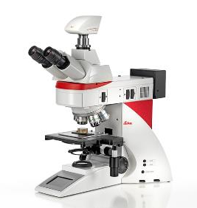
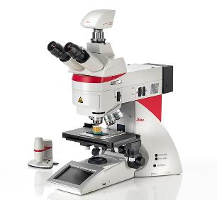
How to decide for a microscope: Part 2 – Application
Solution | DM4 M | DM6 M | Optional Accessories
System | Manual and coded | Automated | DM4 M | DM6 M
Use when... | Reproducible and reliable results for manual inspection with low/moderate sample throughput are needed | Reproducible and reliable results for standardized inspection with high sample throughput are needed. Multiuser environment | xy or xyz automation retrofit: Demand on throughput increases over time | LIBS retrofit: Additional demand for chemical analysis arises over time
Your need... | Manual inspection + Documentation + Analyzing (Measurement) with software | Automated inspection for different tasks or dedicated repetitive tasks (LAS X Steel Expert or Cleanliness Expert) or basic operators + Documentation + Analyzing (Measurement) with software + Automated multisample inspection | Analysis tasks change towards larger/more samples at a time DM4 M is available but budget restricts purchase of a new microscope | Chemical Analysis is required Time constraints don’t allow to wait for overbooked SEM-EDX analysis
Required inspections | Standard sample inspection (Brightfield) Dedicated surface inspection (DIC and Polarization, Darkfield) Fracture analysis (fluorescence contrast)

Slide 9
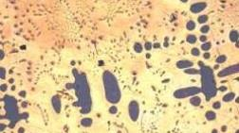
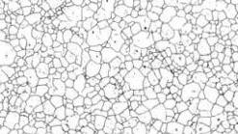

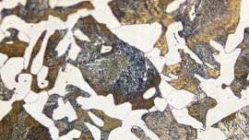
Material analysis tasks
Phase Analysis in Alloys
Grain Size Analysis in Steel and other Materials
Barker Etching (Aluminum)
Ferrite/Pearlite Analysis in Steel & Cast Iron

Slide 10
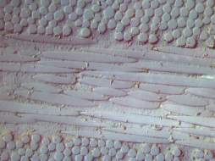
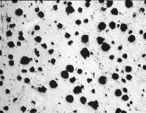
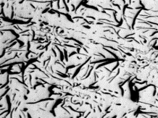
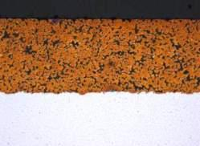
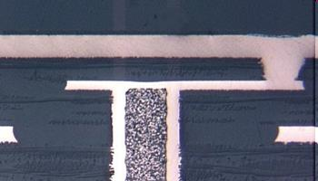
Material analysis tasks
Composites
Graphite Analysis
Layers and Coatings
PCB Boards

Slide 11
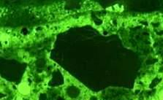


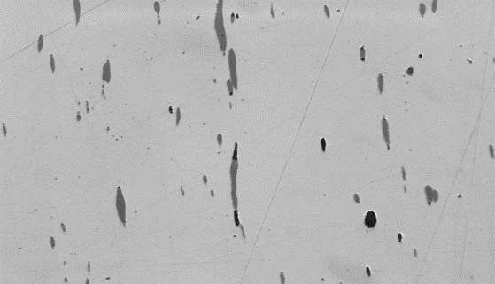
Material analysis tasks
Concrete
Other Materials
Failure Analysis
Non-Metallic Inclusions

Slide 12
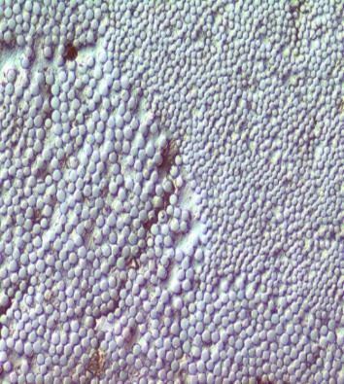
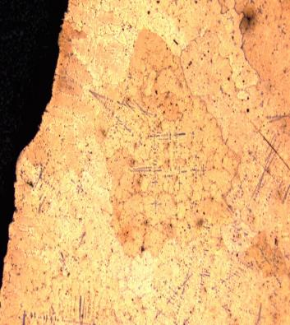
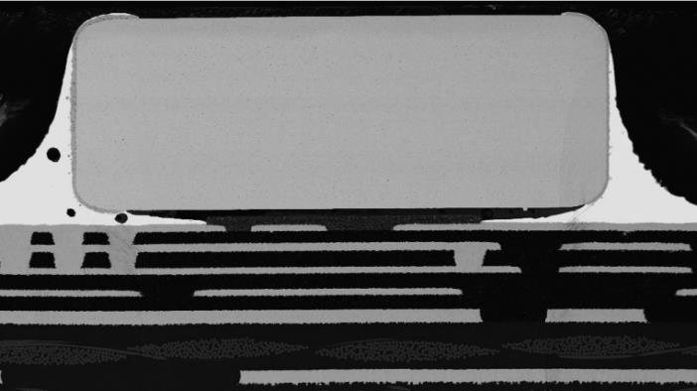
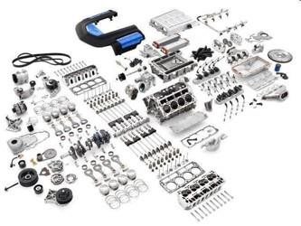
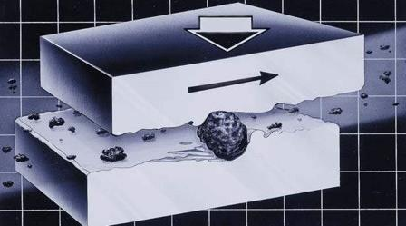
Material analysis tasks
Raw Materials
Manufactured Components
Cleanliness Analysis
Cleanliness Analysis

Slide 13
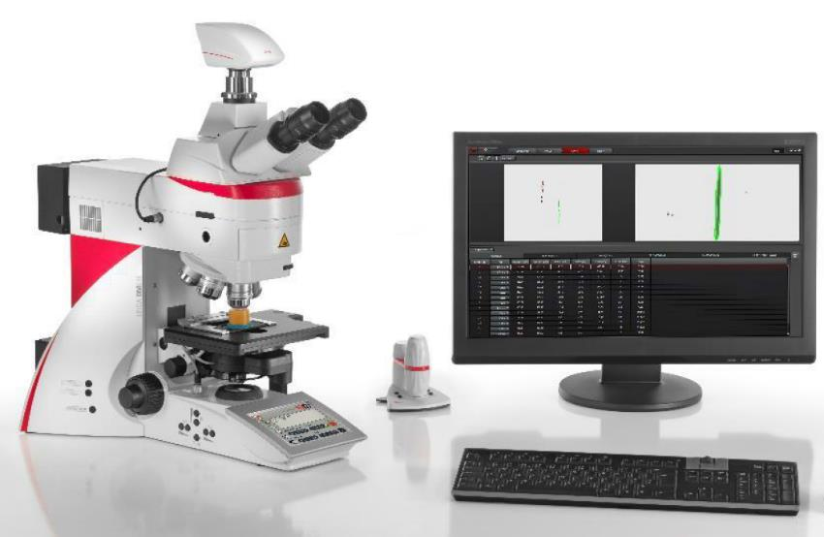
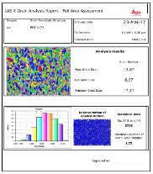
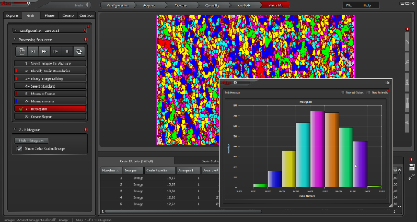
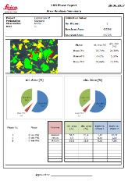
Summary
Get your results with minimum effort to improve your product quality decisions within shorter time of study
Automated illumination and contrast settings for repeatable and reproducible analysis
Intelligently automated or coded nosepiece for fast and secure operation
Build-in high-definition darkfield for more information on the sample surface within shorter time
Powerful system performance by combination of dedicated software modules for:
General measurement tasks
Metallography (Non-metallic inclusion rating, Grain size analysis, Phase analysis, Decarburization)
Cleanliness Analysis of manufactured parts

